Slide 1
Solid Principles

Slide 2
Objectives
To understand the main principles of SOLID
Contents
Single-Responsibility Principle
Open/Closed Principle
Liskov Substitution Principle
Interface Segregation Principle
Dependency Inversion Principle
Follow these principals for good design and code

Slide 3
Single Responsibility Principle
Each class should have only one responsibility
Each class should have only one reason to change its behavior
No 'Kitchen Sink' classes.
A class called QA which has all the methods needed to run QA!
This principal promotes decoupling.
If you want to change an aspect, you'll have a lot less code changes
Code is reusable; by combining responsibilities other classes won’t be able to use a single responsibility from the class.
If you've a large class the chances are it's multiple responsibilities
Just break it up into smaller classes which in turn makes the class easier to test.

Slide 4
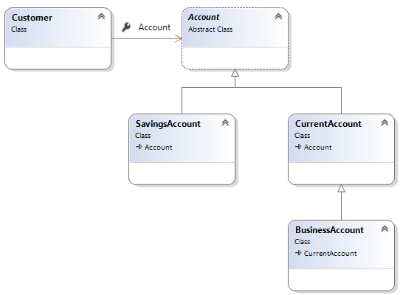
Open Closed Principle
Open for extension, closed for modification.
Software entities should be extendable, but not modifiable.
Changes in requirements are performed using extension rather than modifying existing classes
Apply abstraction and polymorphism.

Slide 5
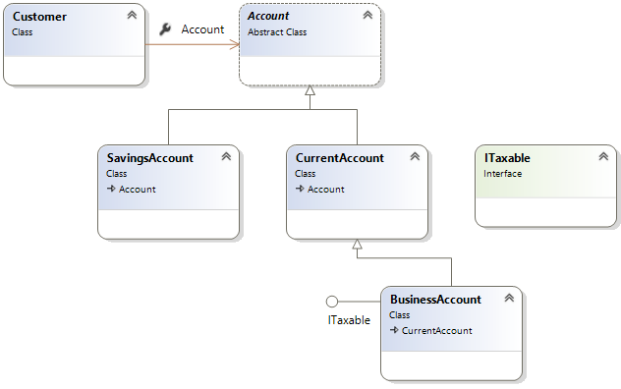
Open Close principal example

Slide 6

Sub-classes behaviour should be the same as the super-classes
Should fulfil all behaviours of the base class correctly.
The behaviour of a derived class should have a stronger post-condition and a weaker precondition than the base class.
(you'll see this in the next few slides)
This principal prevents classes having undesirable behaviours.
Liskov Substitution
Barbara Liskov

Slide 7
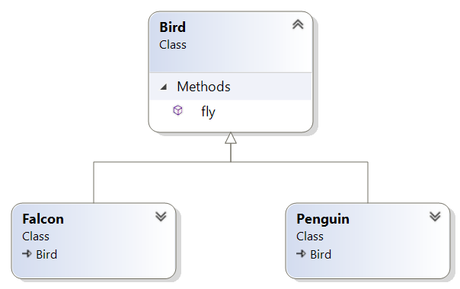


Let’s break Liskov’s principle!
Bird[] birds = { new Falcon(), new Penguin(), new Falcon() };
for (int i = 0; i < birds.Length; i++)
{
birds[i].fly();
}

Slide 8
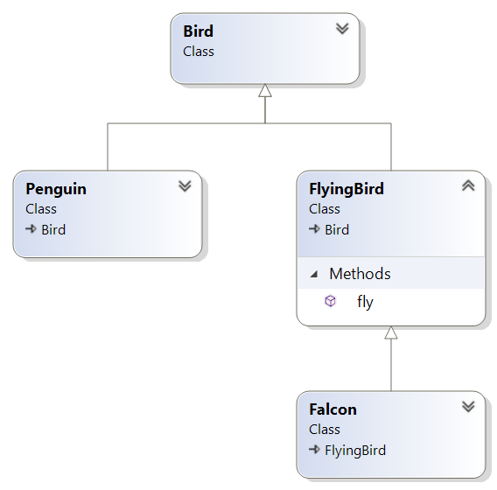
Let’s apply Liskov’s principle

Slide 9
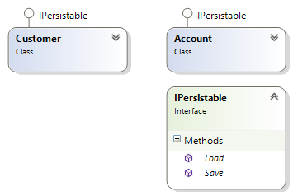
Another example of the Liskov Principle
interface IPersistable {
void Save();
void Load();
}
class Customer implements IPersistable {
int id;
String name;
public void Load() {
// Read a data store and set // the ID and Name properties
}
public void Save() {
// Save instance properties to a permanent data store
}
}

Slide 10
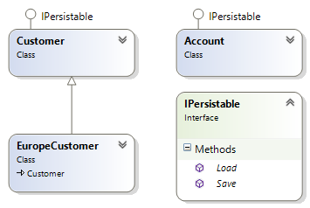
Add a new class called EuropeCustomer
class EuropeCustomer extends Customer
{
@override
public void Save()
{
if (LocalTime.now().getHour() < 12)
{
// Save instance properties
}
}
}
What if the save() method is called in the afternoon?

Slide 11
Now let's try a new Customer class
What happens if one of the objects in the List is an EuCustomer?
public class Manager
{
public void SaveObjects(ArrayList<IPersistable> objects)
{
for(IPersistable item : objects)
{
item.Save();
}
}
public void LoadObjects(ArrayList<IPersistable> objects)
{
for (IPersistable item : objects)
{
item.Load();
}
}
}

Slide 12
High-Level modules should not depend on low-level modules – both should depend on abstractions
Abstractions should not depend on details. Details should depend on abstractions.
Instead of working with hard-wired / highly coupled classes you should always attempt to use interfaces
Let's have a look at a simple example
Dependency Inversion Principle (DIP)
Notes:
You can think of DIP as being an outgoing interface of the ‘dependent’ class rather than an incoming interface of the dependee class. You have to try and establish the abstraction that underlies the application – that set of concepts and behaviours that doesn’t vary when the details are changed.
This is such an important principle that a mechanism has been subsumed into the .NET framework – delegates do exactly this.
It is also sometime known as “The Hollywood Principle” – don’t call us, we’ll call you.

Slide 13
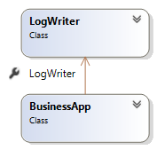
DI example – Bad design
The following code logs message in a console
Higher level class (BusinessApp) has a dependency on a concrete class (LogWriter)
This violates the DI principle
What if you want to send email instead?
class LogWriter {
public void Write(String message) {
qa_WriteAllText("Log.txt", message);
}
}
class BusinessApp {
LogWriter logger = new LogWriter();
public void Log(String message) {
logger.Write(message);
}
}

Slide 14
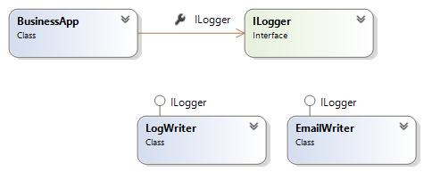
DI Example – Better design
The BusinessApp now depends on abstractions (ILogger interface)
BusinessApp has now got the freedom to Log messages using emails

Slide 15
The C# Code for our DI first attempt
interface Ilogger {
void Write(String message);
}
class LogWriter : Ilogger {
public void Write(String message) {
qa_WriteAllText("log.txt", message);
}
}
class EmailWriter : Ilogger {
public void Write(String message) {
Outlook.Send("admin@qa.com", message);
}
}
class BusinessApp {
ILogger logger;
public void Log(String message) {
if (logger == null)
logger = new LogWriter();
logger.Write(message);
}
}
Could improve!

Slide 16
Dependency Injection
Is for injecting the concrete implementation into a class that uses an abstraction (like an interface)
You can inject dependencies in a Method/Constructor/Property
public class BusinessApp {
ILogger logger;
public BusinessApp(ILogger messageLogger) {
logger = messageLogger;
}
}
static void Main(String[ ] args)
{
BusinessApp app = new BusinessApp(new EmailWriter());
// other code
}

Slide 17
Dependency Injection an alternative
Example shows how to inject a dependency in a Method
public class BusinessApp {
public void Log(String message, ILogger messageLogger) {
logger.Write(message);
}
}
static void Main(String[ ] args)
{
BusinessApp app = new BusinessApp();
app.Log("Hello!", new EmailWriter());
}

Slide 18
Interface Segregation
Interfaces should be specific to a client. Many specific interfaces are better than one general purpose interface.
By using specific interfaces, it will present a clear understanding on what behaviours the client should use.
Additionally segregating interfaces increases usability of interfaces as interface implementers should only use behaviours that are relevant.
Let's have a look at an example…

Slide 19
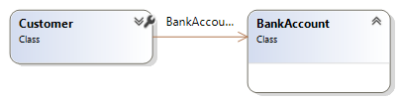
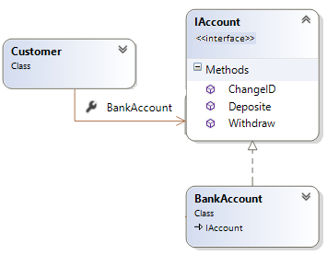
Customer association to a bank account
First attempt: What could be the problem with this design?
Second attempt: Is this solution better? Why?
Yes! Customer can extend another class
But what could be a problem with this solution?

Slide 20
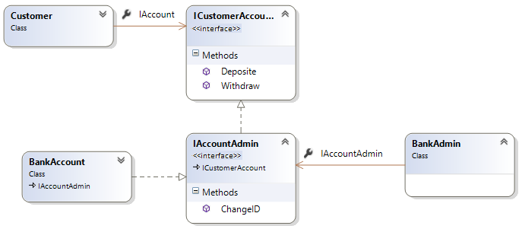
Third attempt – Create many interfaces
We should not allow customers to change their account ID!
How would you solve this problem?
The answer is to give customers their own account interface
The bank should have the ability to change IDs and also have the same capabilities as a customer

Slide 21
Symptoms of a degrading design
Rigidity, fragility, immobility, viscosity
Degradation of dependency architecture
SOLID
Review

